Slide 1
Groundwater Monitoring Assessment at the Falls City, Texas,
Uranium Tailings Disposal Site
Elyssa N. Baker, Raymond H. Johnson, and Stacy Trowbridge
U.S. Department of Energy
Office of Legacy Management
2024 NASA Space Grant Consortium
Tucson, Arizona
April 20, 2024
Notes:
I feel very fortunate that I have been under the mentorship of Geochemists, Ray Johnson and Stacy Trowbridge and that I have been able to learn so much from them.

Slide 2
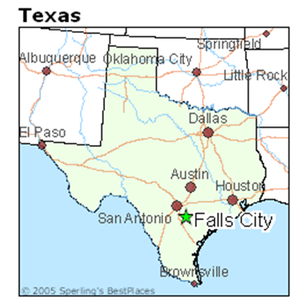
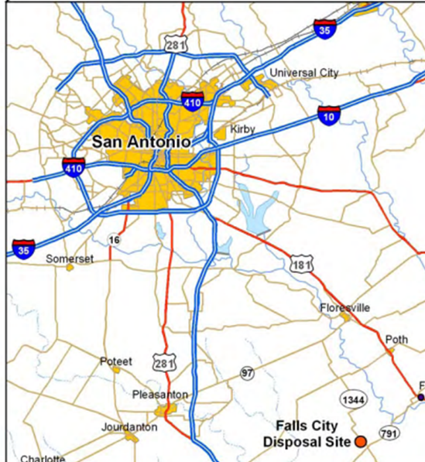
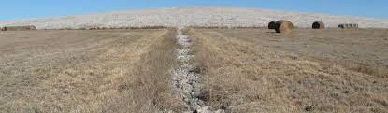
Site Overview & Assessment Purpose
DOE LM would like to discontinue or reduce monitoring at the Disposal Site at Falls City, Texas.
LM must “demonstrate that legacy contamination is not affecting downgradient groundwater quality,” per the 2008 Falls City, Texas, Long-Term
Surveillance Plan.
Notes:
LM must gain concurrence from the Nuclear Regulatory Commission (NRC) to discontinue monitoring the site
Currently, well monitoring is not required legally, but is done as a best management practice according to the LTSP
In this assessment we will address the feasibility of discontinuing monitoring activities at the site while ensuring the LM Mission which is to “Protect Human Health and the Environment”
The site, located in Karnes County, Texas,
sits roughly eight miles southwest of Falls City and 46 miles southeast of San Antonio.
Surrounding areas consist of cleared ranchlands mainly utilized for agriculture, particularly livestock farming like cattle.
Despite its proximity to San Antonio, the population remains relatively small.

Slide 3
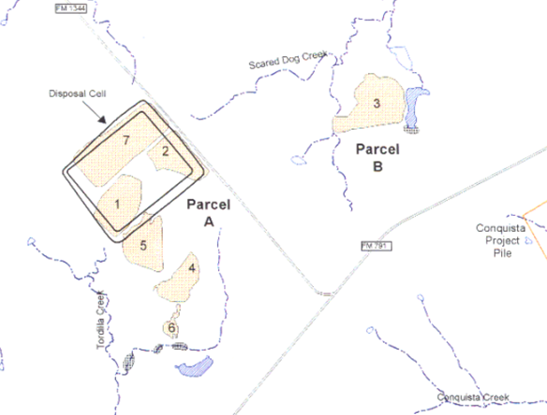
Falls City, Texas, Uranium Mill and Disposal Site History
1959: Open-pit uranium mining began.
1961-1973: First uranium mill operated on site using sulfuric acid-leach process.
1978-1982: Secondary recovery
of uranium using ISR (in-situ recovery, acid leaching).
1992-1994: Tailings moved to
disposal cell.
1997: U.S. Nuclear Regulatory Commission agreed with the
site’s Long-Term Surveillance Plan.
Open Pits/Tailings Impoundments
Disposal Cell
Falls City Site
From 1998 Environmental Assessment of Ground-Water Compliance at Falls City, Texas
Notes:
Tell story using figure:
1954 Uranium discovered in the Gulf Coastal Plains of Karnes County
5 years later open pit mining commenced which opened Parcel A and Parcel B
2 years later, Mill operations to extract said uranium were conducted on site using sulfuric acid leaching. The mill tailings were returned to the open pits.
However, a second extraction was conducted 5 years later by Solution Engineering (SEI) and its partner, Basic Resources who bought the site from the previous owners. Tailings were again restored to their pits.
4. So, over time these tailings were blown by wind spreading radioactive materials. Finally in 1992 remedial efforts began to collect all the outlying contaminated soil. This soil was placed in Ponds 1,2, and 7 where they were buried under an engineered disposal cell. All other ponds were left to evaporate. (POINT OUT WITH POINTER)
5. 3 years later NRC: U.S. Nuclear Regulatory Commission concurred with the LTSP for the disposal site.

Slide 4

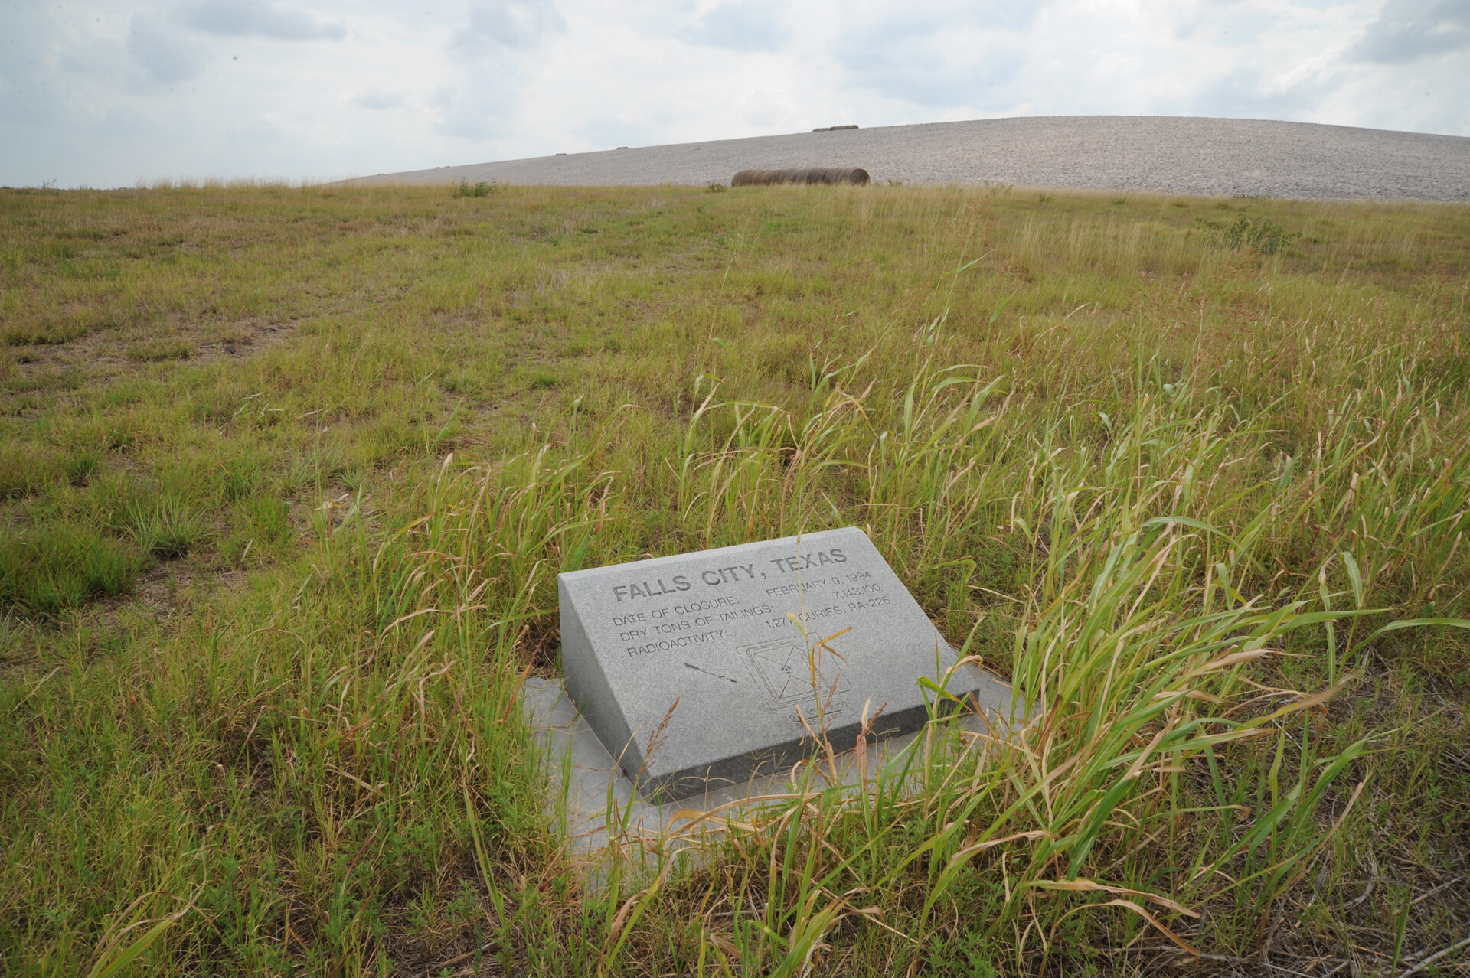
Compliance Strategy and Monitoring Decision
No remediation.
  Elevated background concentrations of uranium (not drinking water quality).
  Classification as limited use for livestock and irrigation.
Approach: still meeting this class of use?
Notes:
At Falls City there is no remediation plan for the underlaying aquifers. This is because:
The Dilworth aquifer has a naturally high background Uranium concentration, and will never be used for human consumption, but meets the standard to be used for livestock and *irrigation* (ask Ray). We want to evaluate if it is still meeting this class of use.
Background Uranium concentration represents the quality of groundwater that has not been influenced by uranium processing activities at a disposal site. We use this value to compare to our current groundwater Uranium concentration to see how much the acid leaching from tailings pits has affected the uranium levels of the groundwater.
*Ask Ray about limited use for livestock and irrigation if that is talking about the lower aquifer*

Slide 5
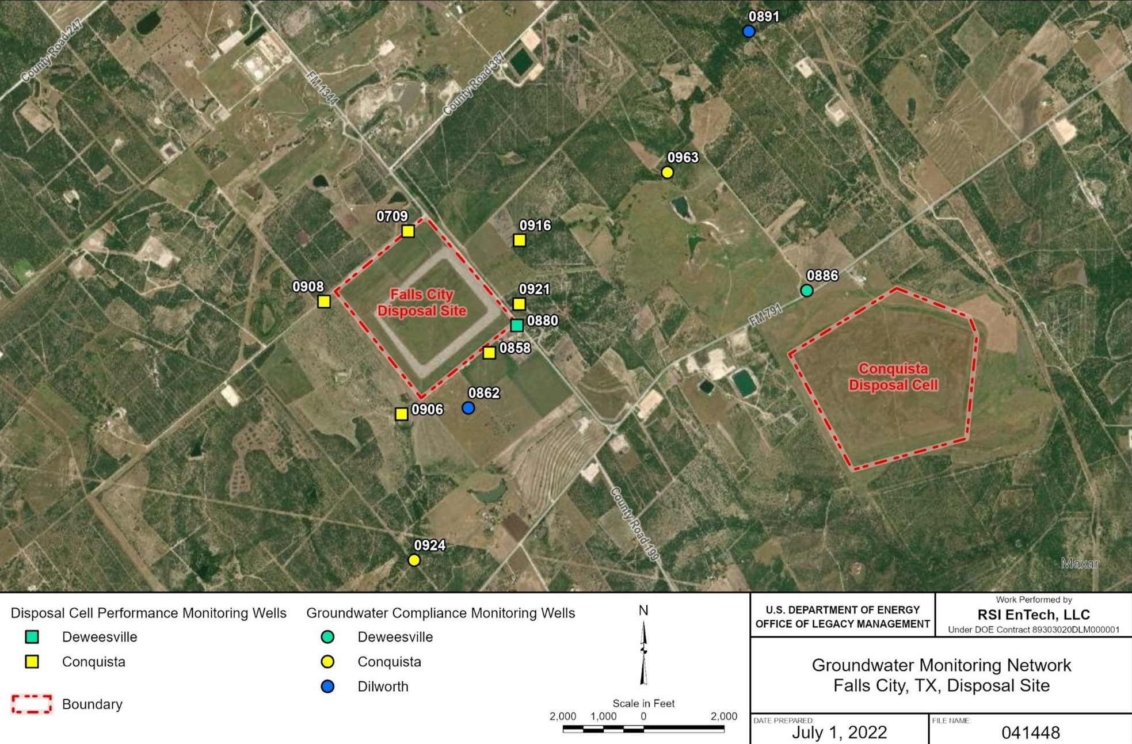
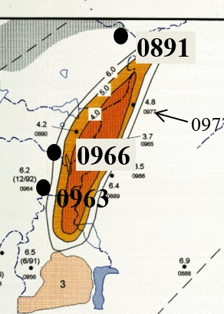
Monitoring Wells at the Falls City Disposal Cell
pH
Notes:
Here is the disposal cell and here is the open area that had previously contained sulfuric acid mixed with tailings for about 10 years before the cell was constructed.
The main concern that has been raised in whether the site should or should not discontinue monitoring is the flow of a uranium plume stemming from Pit 3 detected through monitoring wells downgradient. There are no monitoring wells downgradient from well 0891, which is the where the plume was detected, so it is hard to say.

Slide 6
Uranium Concentration at Monitoring Well 0891
Highest Well Concentration = 3.6 mg/L
Background = 0.094 mg/L
Livestock Guideline = 0.20 mg/L
Notes:
Here is the evidence of what we do have from that monitoring well.
-Background water quality as we mentioned is the representative water quality of groundwater that has not been influenced by uranium processing activities at a disposal site
The graph tells us that an acid leach plume passed the MW from 2008 to 2021. Graph shows that it has pretty much already passed, but we dont know where it is exactly.

Slide 7

Conceptual Groundwater Flow of pH Plume *not to scale*
Improperly Abandoned Mining Exploration Wells
Open Pit with Tailings
Now with clean backfill
891
U livestock guideline = 0.2 mg/L
San Antonio River
Deweesville Aquifer
Groundwater Flow Direction
Conquista Confining Unit
Dilworth Aquifer
Plume
U Maximum Background = 0.094 mg/L
?
U = up to 3 mg/L
Notes:
Here is a conceptual model of what may be happening with the groundwater at the site.
Livestock Guideline Source: 2005 CCME (Canadian Environmental Quality Guidelines) Canadian Water Quality Guidelines for the Protection of Agricultural Water Uses
It is SUSPECTED that a possible pathway to the lower dilworth aquifer from the upper deweesville aquifer was created through an oil or gas well that’s integrity was compromised when it was abandoned. *Ask Ray about this again*
The background here had been reported as 0.094 mg/L, but with our evidence from the monitoring well, it has exceeded this level and has reached 3.6mg/L
Guidelines suggest that uranium concentration levels should not exceed 0.2 mg/L in water that is intended to be used for livestock.
Somewhere downgradient of monitoring well 0891 a farmer could drill a well for his cows and this water could become a key exposure of this contamination.

Slide 8
Conclusions
Majority of contaminant plume has passed through well 0891.
Uranium concentrations exceed livestock watering guidelines.
Original best management practice goal of confirming that “legacy contamination is not affecting downgradient groundwater quality” is not being met.
The site still needs to be monitored.
In addition to LM's current practice of researching well permits in the area and notifications, this study has informed an area of concern for sending letters to landowners indicating that groundwater should not be used.
Notes:
Yay science-based suggestions are implemented.

Slide 9
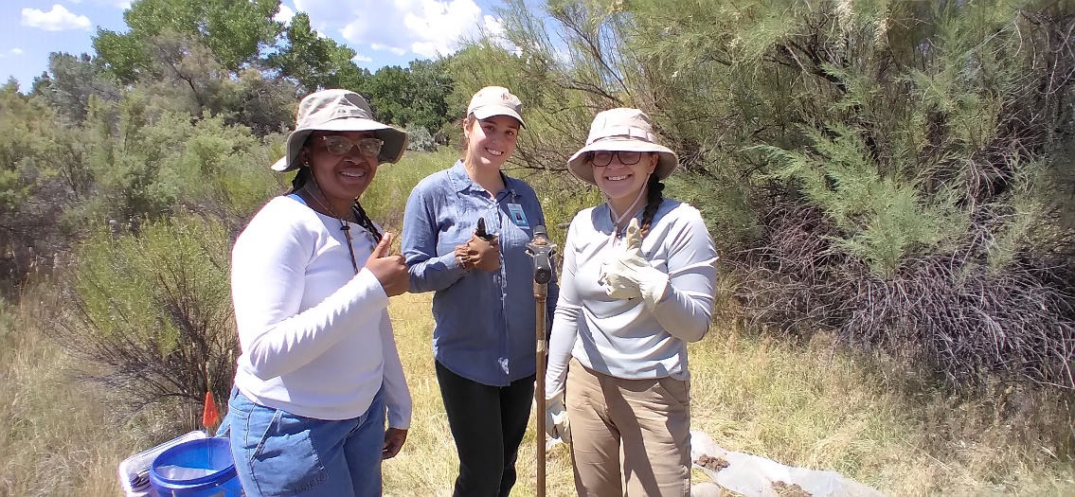
Thank you!
Special thanks to:
  Angelita Denny and Mary Young, who have collaborated with Clarence T. Brown and Dean Wess from Pre-College University to make the MES program possible
  Raymond Johnson, Stacy Trowbridge, Charlee Boger, and LM, who have mentored me through my internship experience and made this presentation possible
  Alexis-Marie Parrish and KennaLee Rowley, for their support and kindness throughout our internship experience together
Notes:
I feel very fortunate that I had been under the mentorship of Geochemists, Ray Johnson and Stacy Trowbridge while I was at Grand Junction, CO last summer and that I have been able to learn so much from them.

